Slide 1
Digital Platforms Overview
Dr.Esraa Ferwana

Slide 2
Why Digital Platforms Matter
Help students develop practical skills.
Support real projects and portfolios.
Connect learning with career opportunities.
Prepare students for remote work.

Slide 3
Platform Selection Logic
Use platforms for learning.
Use platforms for coding practice.
Use platforms for sharing work.
Use platforms for networking.
Use platforms for freelancing later

Slide 4
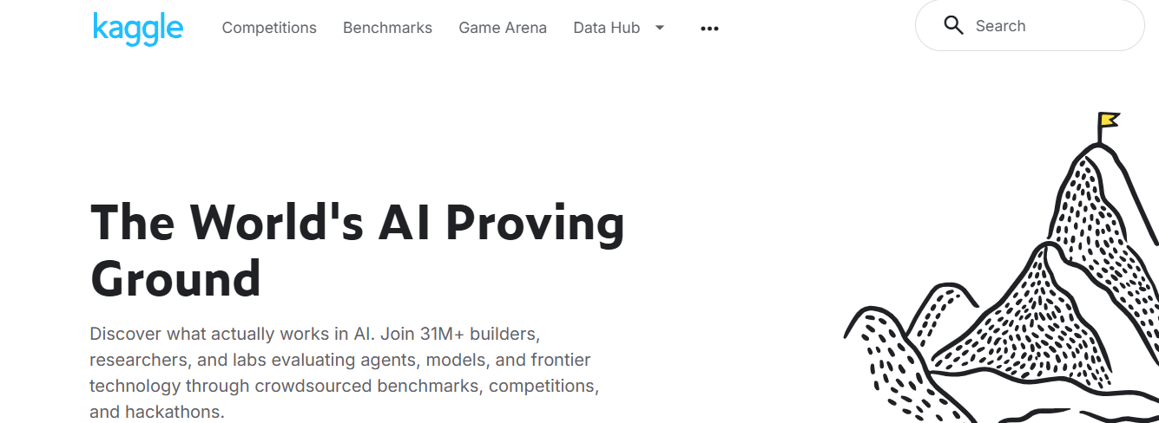

Slide 5
Kaggle
Learn Python, data visualization, machine learning, and AI.
Work on datasets and competitions.
Build practical data science projects.
Learn from the global AI community

Slide 6
How to Use Kaggle
Start with beginner courses.
Practice on small datasets.
Read notebooks from other users.
Publish your own notebook.
Join competitions later.

Slide 7


Slide 8
Run notebooks directly in the browser.
No local setup required.
Supports Python, ML, and data analysis.
Provides access to GPUs and collaborative work

Slide 9
How to Use Colab
Test code quickly.
Train models on cloud resources.
Combine code and explanation in one notebook.
Share notebooks with classmates or clients.
Use it for class assignments and mini-projects.

Slide 10


Slide 11
Explore models, datasets, and AI applications.
Use it for NLP, vision, and generative AI.
Share and reuse machine learning resources.
Learn from an active AI community.

Slide 12
Why Hugging Face Matters
It exposes students to real AI workflows.
It connects theory with deployable models.
It helps students learn modern AI tools.
It supports collaboration and sharing.

Slide 13


Slide 14
Build a professional identity.
Show your projects and skills.
Connect with recruiters and professionals.
Find internships and remote opportunities.

Slide 15
Write a strong headline.
Add projects and certificates.
Share technical posts.
Follow AI and data science companies.
Network professionally.

Slide 16






